Slide 1
Differentiation
Parametric Differentiation, Tangents and Normals
Notes:
T

Slide 2

Parametric Differentiation
Parameter $≡$ in terms of a new, controlled variable
E.g. $x = cos⁡t$
$y = sin⁡t$
So how do we find $\frac{dy}{dx}$?

Slide 3

Parametric Differentiation
Chain rule:
$\frac{dy}{dx}=\frac{dy}{dt}⋅\frac{dt}{dx}$
We can easily get $\frac{dy}{dt}$ and $\frac{dx}{dt}$
Notice that $\frac{dt}{dx}$ is the reciprocal of $\frac{dx}{dt}$

Slide 4
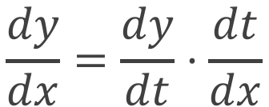
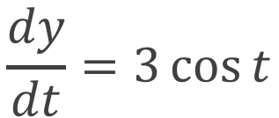
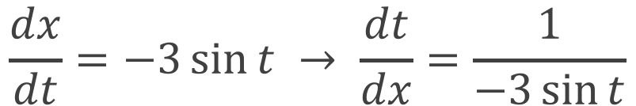
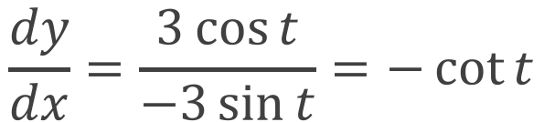
Example 1
Find the derivative of the circle defined by $x=3 cos⁡t$, $y=3 sin⁡t$
$$\frac{dy}{dx}=\frac{dy}{dt}⋅\frac{dt}{dx}$$
$$\frac{dy}{dt}=3\cos{t}$$
$$\frac{dx}{dt}=−3\sin{t} → \frac{dt}{dx}=\frac{1}{−3\sin{t}}$$
$$\frac{dy}{dx}=\frac{3\cos{t}}{−3\sin{t}}=−\cot{t}$$

Slide 5


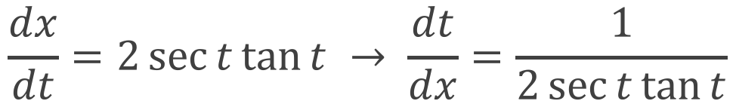
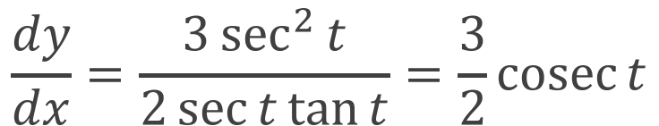
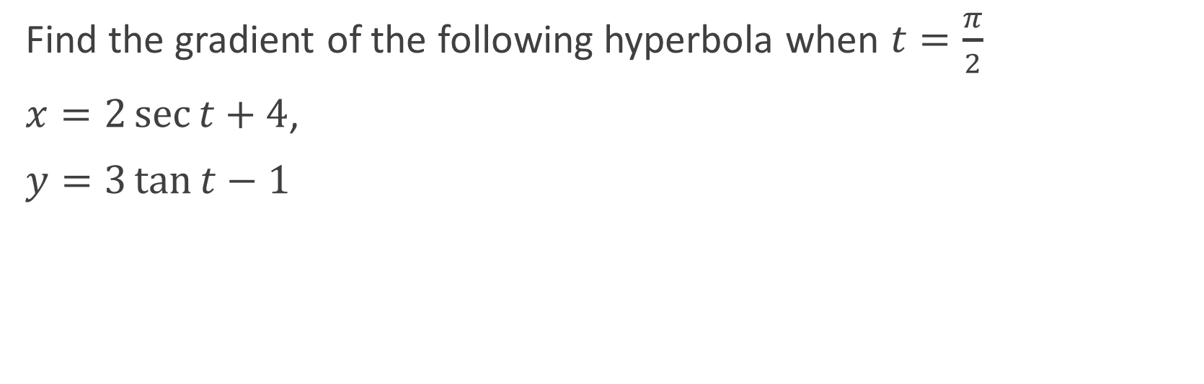
Example 2
Find the gradient of the following hyperbola when $t=\frac{π}{2}$
$x=2\sec{t}+4$,
$y=3\tan{t}−1$
$$\frac{dy}{dx}=\frac{dy}{dt}⋅\frac{dt}{dx}$$
$$\frac{dy}{dt}=3\sec^{2}{t}$$
$$\frac{dx}{dt}=2\sec{t}\tan{t} → \frac{dt}{dx}=\frac{1}{2\sec{t}\tan{t}}$$
$$\frac{dy}{dx}=\frac{3\sec^{2}{t}}{2\sec{t}\tan{t}}=\frac{3}{2}\text{cosec}{t}$$

Slide 6



Example 2
Find the gradient of the following hyperbola when $t=\frac{π}{2}$
$x=2\sec{t}+4$,
$y=3\tan{t}−1$
$$\frac{dy}{dx}=\frac{3}{2}\text{cosec}{t}$$
$${\left.\frac{dy}{dx}\right|}_{t=\frac{π}{2}}=\frac{3}{2}\text{cosec}{\frac{π}{2}}$$
$$=\frac{3}{2}$$

Slide 7



Second Order Parametric Differentiation
Now we’ve found $\frac{dy}{dx}$, how do we find $\frac{d^{2}y}{dx^{2}}$?
$$\frac{d^{2}y}{dx^{2}}=\frac{d}{dx}\left(\frac{dy}{dx}\right)$$
$$=\frac{dt}{dx}⋅\frac{d}{dt}\left(\frac{dy}{dx}\right)$$

Slide 8
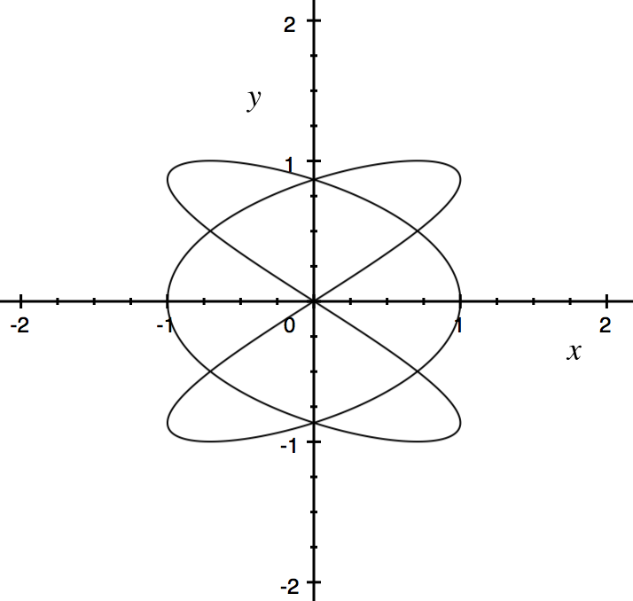

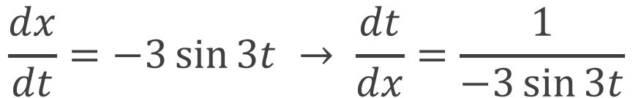
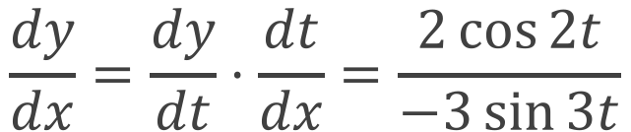

Example
Find the second derivative of the ellipse given by $x=\cos{3t}$, $y=sin⁡2t$
$$\frac{dy}{dt}=2\cos{2t}$$
$$\frac{dx}{dt}=−3\sin{3t} → \frac{dt}{dx}=\frac{1}{−3\sin{3t}}$$
$$\frac{dy}{dx}=\frac{dy}{dt}⋅\frac{dt}{dx}=\frac{2\cos{2t}}{−3\sin{3t}}$$

Slide 9
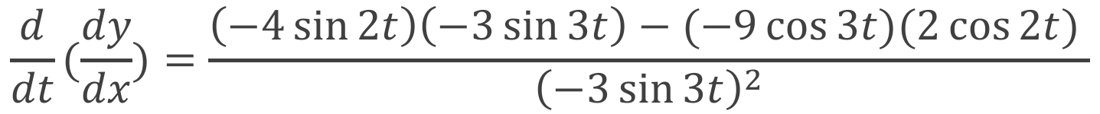
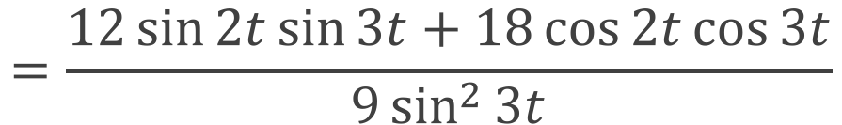
Example
Find the second derivative of the ellipse given by $x=\cos{3t}$, $y=sin⁡2t$
$$\frac{d}{dt}(\frac{dy}{dx})=\frac{\left(−4\sin{2t}\right)\left(−3\sin{3t}\right)−(−9\cos{3t})(2\cos{2t}) }{{\left(−3\sin{3t}\right)}^{2}}$$
$$=\frac{12\sin{2t}\sin{3t}+18\cos{2t}\cos{3t}}{9\sin^{2}{3t}}$$
$$\frac{d^{2}y}{dx^{2}}=\frac{dt}{dx}⋅\frac{d}{dt}\left(\frac{dy}{dx}\right)=\frac{1}{−3\sin{3t}}⋅\frac{12\sin{2t}\sin{3t}+18\cos{2t}\cos{3t}}{9\sin^{2}{3t}}$$

Slide 10
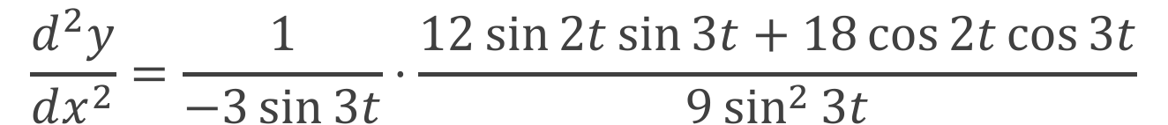
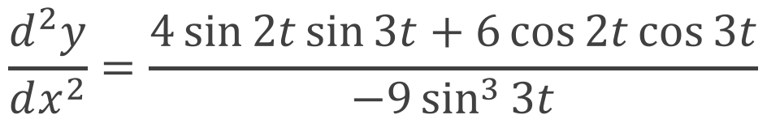
Example
Find the second derivative of the ellipse given by $x=\cos{3t}$, $y=sin⁡2t$
$$\frac{d^{2}y}{dx^{2}}=\frac{1}{−3\sin{3t}}⋅\frac{12\sin{2t}\sin{3t}+18\cos{2t}\cos{3t}}{9\sin^{2}{3t}}$$
$$\frac{d^{2}y}{dx^{2}}=\frac{4\sin{2t}\sin{3t}+6\cos{2t}\cos{3t}}{−9\sin^{3}{3t}}$$

Slide 11
Practice
Delta Workbook
Exercises 15.1-15.4, pp147-155
Workbook
Pages 44-46

Slide 12
Tangents and Normals
A tangent is a straight line touching and parallel to a curve at a specific point.
A normal is a straight line touching and perpendicular to a curve at a specific point.

Slide 13
Tangents and Normals
Tangent
Normal

Slide 14

Tangents and Normals
Equation of tangent to $f$ at $x_{1}$
$y −f\left(x_{1}\right)=f^{′}\left(x_{1}\right)×(x−x_{1})$
Equation of normal to $f$ at $x_{1}$
$y −f\left(x_{1}\right)=\frac{−1}{f^{′}\left(x_{1}\right)}×(x −x_{1})$
Both of these are $y–y_{1}=m(x–x_{1})$ with specific $m$

Slide 15
Tangents and Normals
What are tangents used for?
Visualising Gradients
Geometry
Physics (particularly slipping and breaking)
Economics (particularly interpolation)

Slide 16
Tangents and Normals
What are normals used for?
Geometry (particularly ‘nearest point’ calculations)
Computer Graphics (particularly for ‘raytracing’)
Physics (particularly forces like friction and support)
When the tangent is undefined

Slide 17
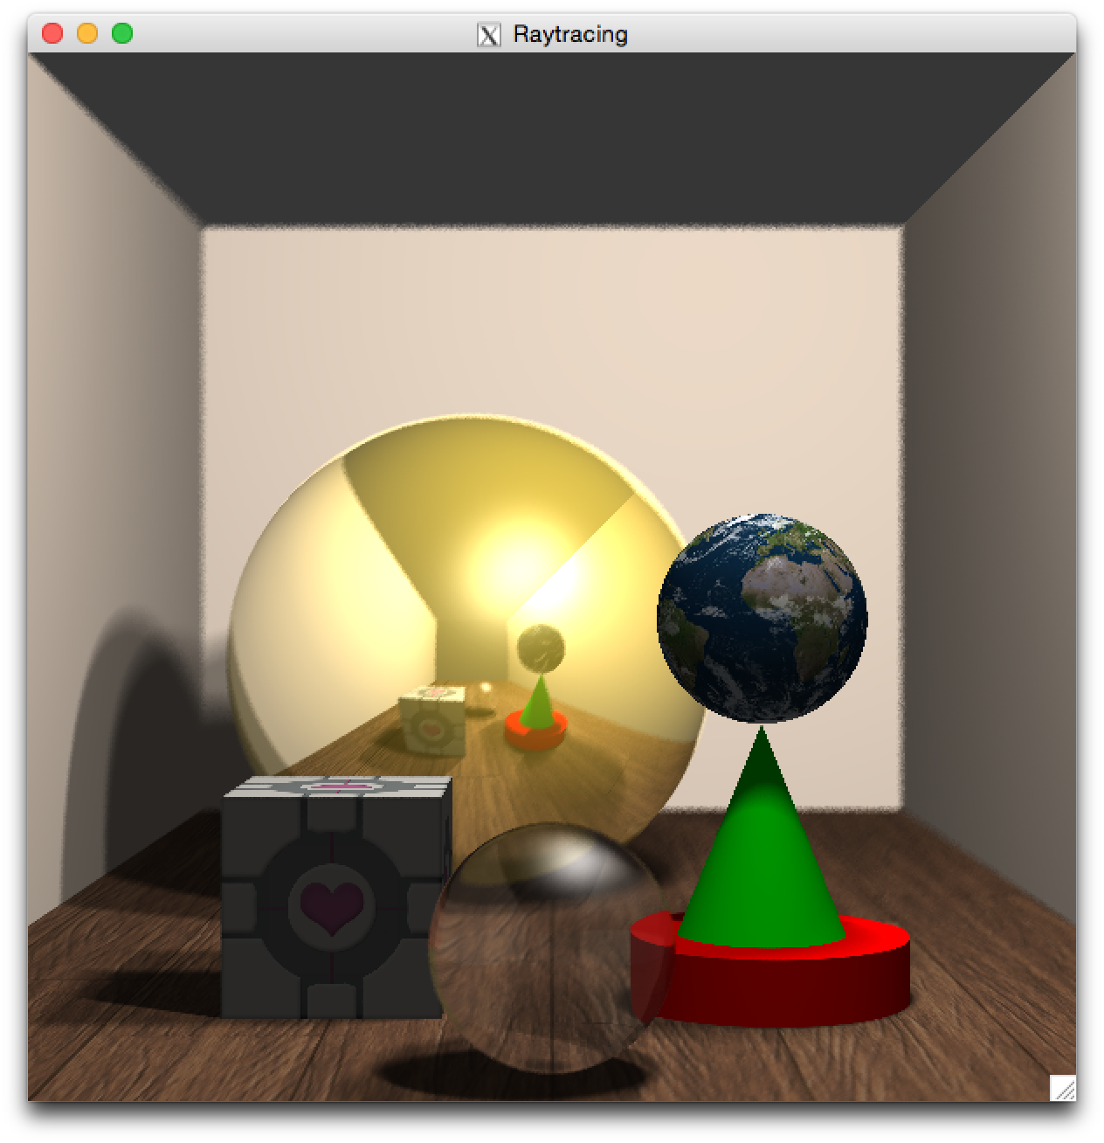
Notes:
This is an example of an image generated by a ray-tracer, made by Aaron Stockdill. The code makes extensive use of Normals.

Slide 18
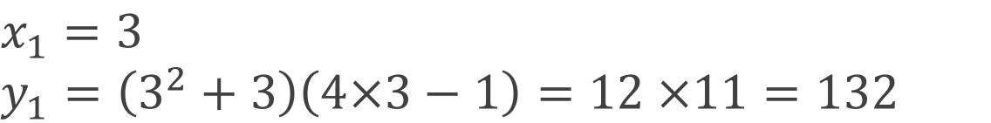
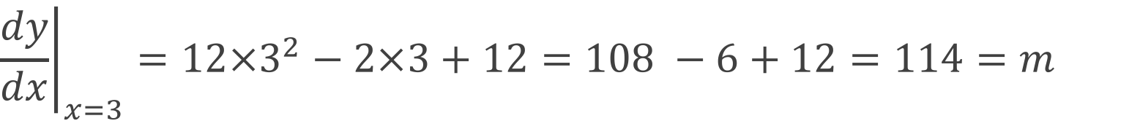

Example 1
Find the tangent to the function $y=(x^{2}+3)(4x−1)$ when $x=3$.
$$x_{1}=3$$
$$y_{1}=\left(3^{2}+3\right)\left(4×3−1\right)=12 ×11=132$$
$$\frac{dy}{dx}=2x\left(4x−1\right)+4\left(x^{2}+3\right)=12x^{2}−2x+12$$
$${\left.\frac{dy}{dx}\right|}_{x=3}=12×3^{2}−2×3+12=108 −6+12=114=m$$
$$y−y_{1}=m(x−x_{1})$$
$$y=114x−210$$

Slide 19

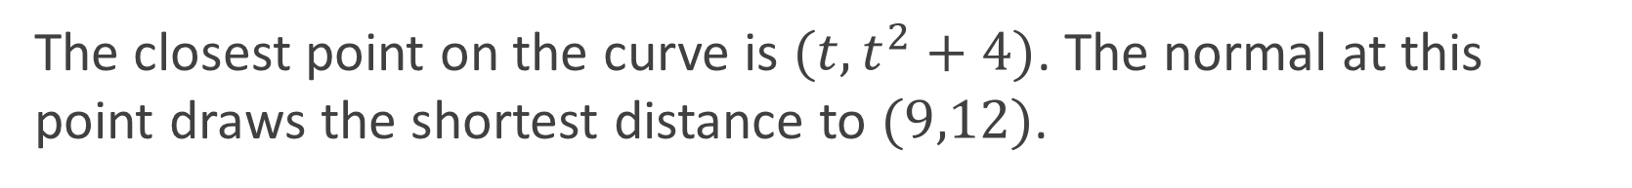


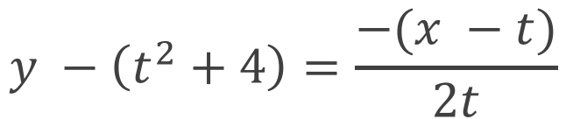
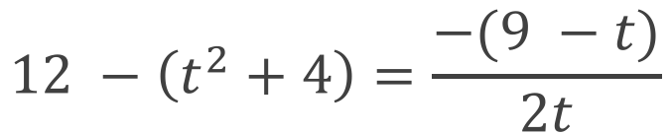

Example 2
Find the point on the curve $y=x^{2}+4$ closest to the point $(9,12)$.
The closest point on the curve is $(t,t^{2}+4)$. The normal at this point draws the shortest distance to $(9,12)$.
$$\frac{dy}{dx}=2x$$
$$y −\left(t^{2}+4\right)=\frac{−(x −t)}{2t}$$
$$12 −\left(t^{2}+4\right)=\frac{−(9 −t)}{2t}$$
$$m=\frac{−1}{2t}$$
$$0 =−9−15t+2t^{3}$$
Notes:
This could be done other ways, but we’re going to use normals.
All ways eventually result in solving 2x^3 – 15x – 9 = 0, so they aren’t “easier”.

Slide 20


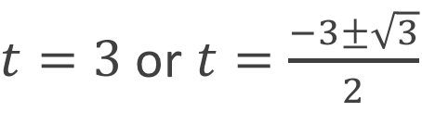
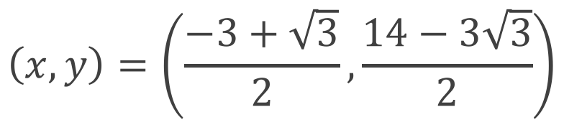
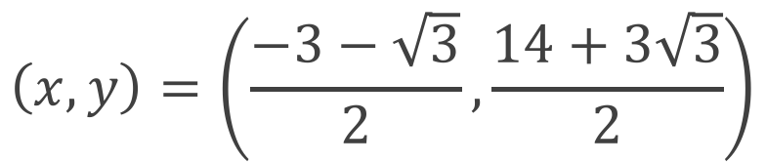

Example 2
Find the point on the curve $y=x^{2}+4$ closest to the point $(9,12)$.
The closest point on the curve is $(t,t^{2}+4)$. The normal at this point draws the shortest distance to $(9,12)$.
$$0 =−9−15t+2t^{3}$$
$$\left(x,y\right)=\left(3, 13\right)$$
$$\left(x,y\right)=\left(\frac{−3+\sqrt{3}}{2},\frac{14−3\sqrt{3}}{2}\right)$$
$$0 =(t−3)(2t^{2}+6t+3)$$
$t=3$ or $t=\frac{−3±\sqrt{3}}{2}$
$$\left(x,y\right)=\left(\frac{−3−\sqrt{3}}{2},\frac{14+3\sqrt{3}}{2}\right)$$

Slide 21
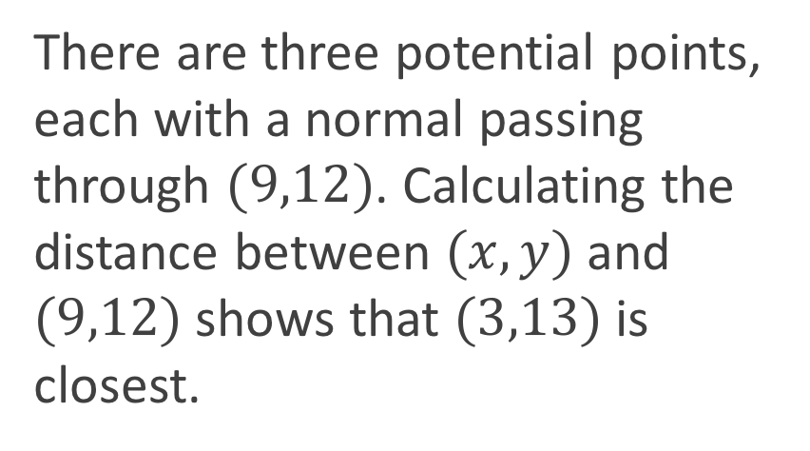
Example 2
Find the point on the curve $y=x^{2}+4$ closest to the point $(9,12)$.
The closest point on the curve is $(t,t^{2}+4)$. The normal at this point draws the shortest distance to $(9,12)$.
There are three potential points, each with a normal passing through $(9,12)$. Calculating the distance between $(x,y)$and $(9,12)$shows that $(3,13)$is closest.
$$\left(x,y\right)=\left(3, 13\right)$$
$$\left(x,y\right)=\left(\frac{−3+\sqrt{3}}{2},\frac{14−3\sqrt{3}}{2}\right)$$
$$\left(x,y\right)=\left(\frac{−3−\sqrt{3}}{2},\frac{14+3\sqrt{3}}{2}\right)$$

Slide 22
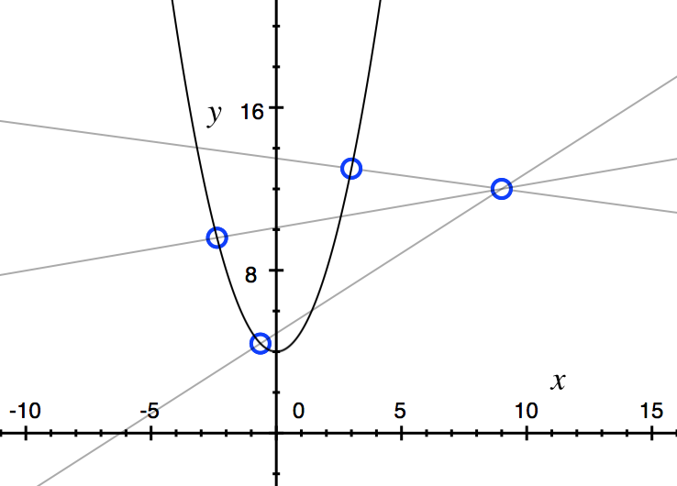
Example 2
Absolute Minima
Relative Minima
Relative Maxima
Notes:
The picture of what’s going on, the three solutions, and a description of what’s going on:
Minima mean that if you go along the curve in either direction you get farther away
Maxima mean that if you go along the curve in either direction you get closer

Slide 23
Practice
Delta Workbook
Exercise 12.1, p135
Workbook
Pages 47-55

Slide 24
Do Now
Any Questions?
Delta Workbook
Exercises 12.1, 15.1-15.4
Workbook
Pages 44-55

Slide 25

This work is licensed under a Creative Commons Attribution-NonCommercial-ShareAlike 4.0 International License.
Aaron Stockdill
2016

